Slide 1
679 Final Project
Group 11: Chi Zhang, Aoyi Li, Simu Huang, Zixuan Liu
Notes:
Hi everyone, we are group 11 we have chi, aoyi, simu and me as group members, and I will introduce our project to you

Slide 2
Introduction
Used SEER dataset to predict whether patients can survive more than two years or not after diagnosis
Identify the factors that affect the survival of patients less than two years after diagnosis
Descriptive research by EDA to find the relationship between these variables
Notes:
In this project, we mainly focus on the factors that affect the survival time of the head and neck cancer patients after diagnosis and use machine learning methods to predict whether head and neck cancer patients will survive longer than two years. Besides, what we notice was that in the data, the average survival time of the patients is greater than two years. We will also try to identify the factors that affect the survival of patients less than two years after diagnosis and do some descriptive research by EDA to find the relationship between these variables.

Slide 3
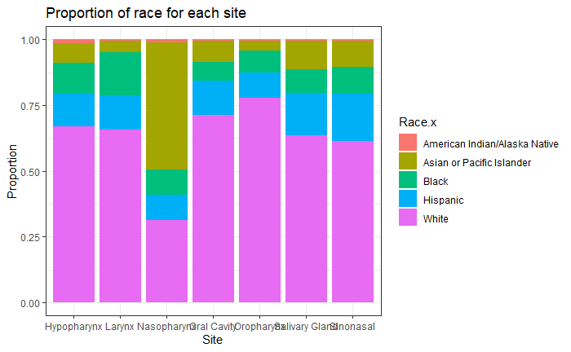
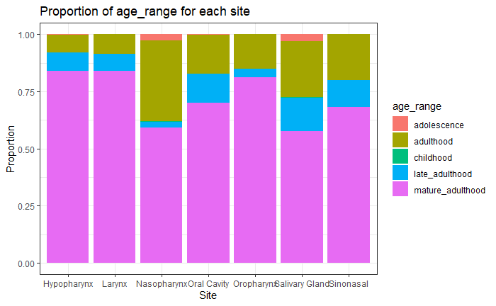
EDA -- interesting findings
Nasopharynx is obviously different from other sites
Notes:
For the 2 plots here, we found that the site called Nasopharynx is obviously different from other sites. From the plot on the left, it is clear that Asian or Pacific Islander people are more likely to have Nasopharynx cancer than other races, we did research based on this finding and found out that asain are more likely to have Nasopharynx cancer than other races, not just our data showing this
and white people are less likely to have this cancer compared to other races. From the plot on the right, we can see that adults ( from age 21-50) are more likely to have Nasopharynx cancer than other age stages.

Slide 4
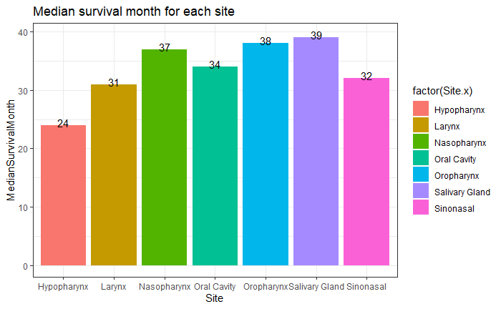
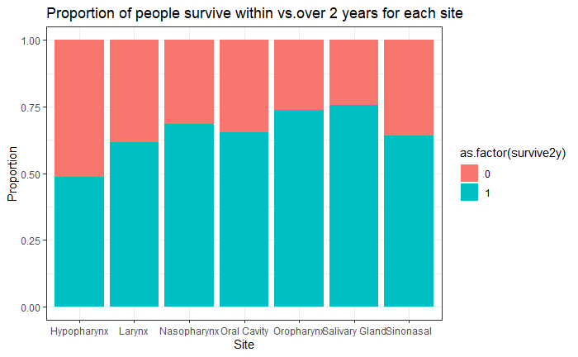
EDA -- Survive within/over 2 years
Almost all cancers here have median survival months more than 2 years
Notes:
We plotted the median survival months for each site, which shows that almost all cancers here have median survival months more than 2 years. Thus, we would like to predict whether a person can survive over 2 years or not after diagnosis. And further understand that if there is any similarity of people who died within 2 years. Both 2 plots above show that people who have Hypopharynx cancer have the lowest survival time and they are most likely to die within 2 years

Slide 5
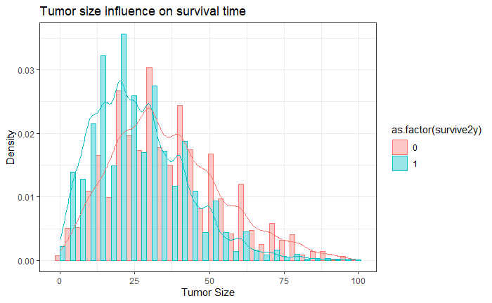
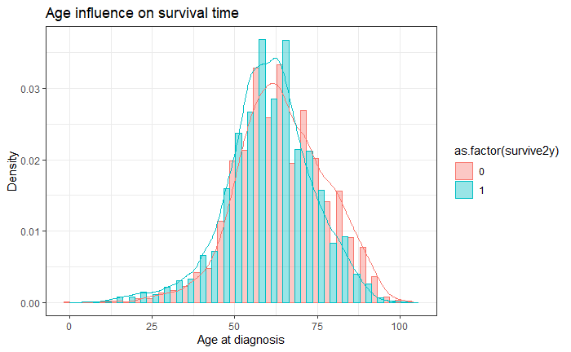
EDA -- Influences of tumor size and age on survival time
Notes:
These 2 density plots show influences of tumor size and age on survival time. When tumor sizes are less than 30, people are more likely to survive more than 2 years. However, when sizes are greater than 30, people are more likely to die within 2 years. For the age plot, the differences between ages are not that clear. People who are in or older than the mature adulthood stage have a larger chance to die within 2 years compared to younger people.

Slide 6
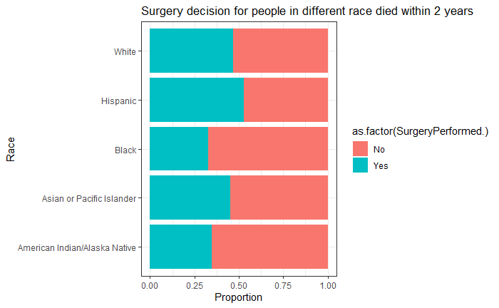
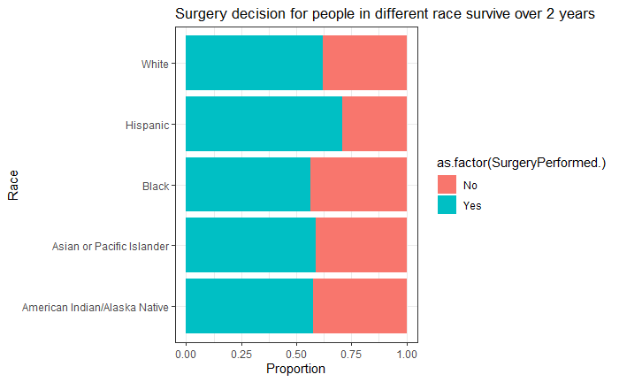
EDA -- whether surgery performance is significant factor
By comparing these 2 plots, we can clearly see the influence of surgery
Notes:
Then we would like to check if surgery performance is a significant factor that affects survival time. By comparing these 2 plots, we can clearly see the influence of surgery. It is clear that more than half of people who died within 2 years did not have surgery. For people who survive more than 2 years, a large proportion of them chose to do surgery. Thus, we can conclude that surgery performance should be an important factor.
we aosl did same exactly graph on chemo and radiation but surgery performance is the most significant among the three

Slide 7
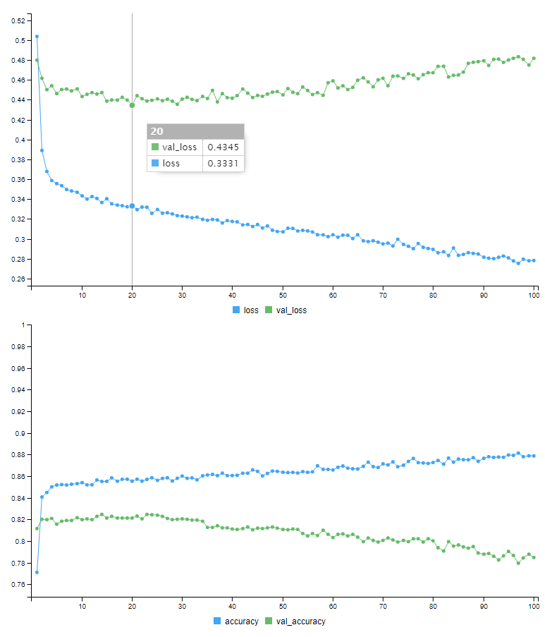
Models
Logistic Regression 0.8434264
XGBoost 0.823
Multi-layer Perceptron 0.849
Confusion Matrix and Statistics
Actual
Prediction 0 1
0 4852 881
1 845 4816

Slide 8
Summary
Limited data from 2010 to 2014
Internal and external factors not listed in the data
Enough for basic diagnosis reference

Slide 9
Thank you for listening!
Any Question?

